Slide 1
Welcome to CSE 143!
Brett Wortzman
Winter 2021
Please make sure your microphone is muted.
If you’re willing, turn on your video so we can see you!

Slide 2
Agenda
About us
About this course
Learning objectives
Other similar courses
Course components
Our learning model
Tools and resources
Course Website
Zoom
Ed
PollEverywhere
Discord
Assessment and grading
Collaboration

Slide 3
Agenda
About us
About this course
Learning objectives
Other similar courses
Course components
Our learning model
Tools and resources
Course Website
Zoom
Ed
PollEverywhere
Discord
Assessment and grading
Collaboration

Slide 4
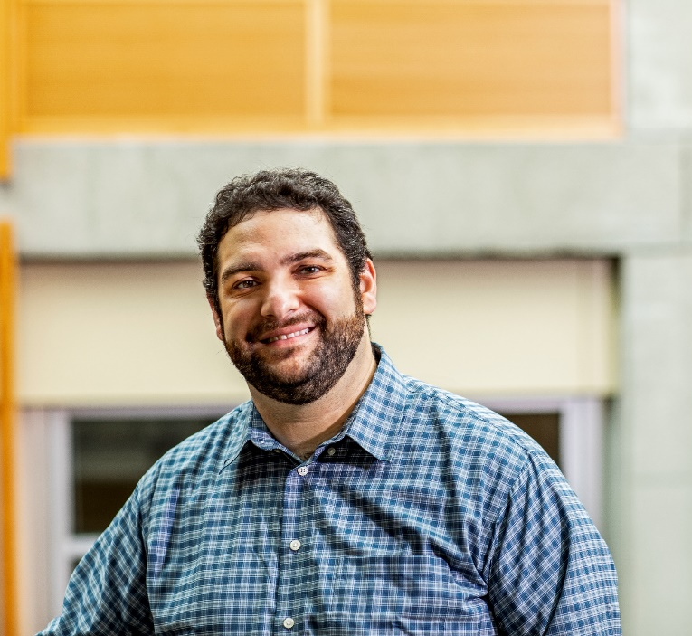
Hi, I’m Brett! (he/him)
Assistant Teaching Professor
Frequent 14X instructor
Also interested in CS education/pedagogy
Previously:
trained CS teachers
developed CS curriculum
taught high school CS
worked as a software engineer

Slide 5
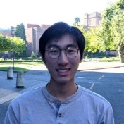
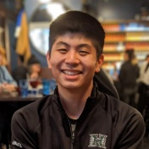
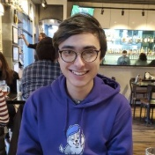
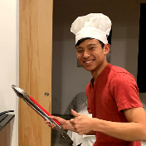
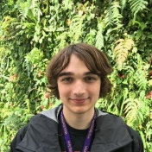
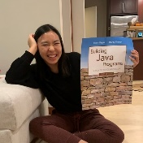
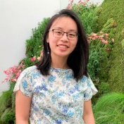
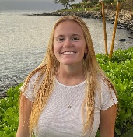
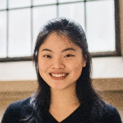
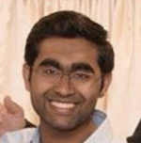
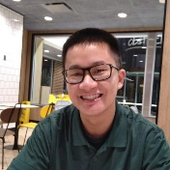
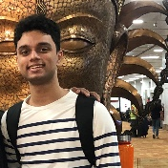
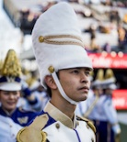
Meet your TAs
Lesson 0 - Winter 2021

Slide 6
Agenda
About us
About this course
Learning objectives
Other similar courses
Course components
Our learning model
Tools and resources
Course Website
Zoom
Ed
PollEverywhere
Discord
Assessment and grading
Collaboration

Slide 7
Learning Objectives
or, “What will I learn in this class?”
Functionality/Behavior: Write functionally correct and efficient Java programs and systems of medium to large length and complexity that meet a provided specification and/or solve a specified problem
Comprehension: Trace and predict the behavior of programs and systems
Data Abstraction: Select and apply appropriate abstract data types to manage program state
Data Structures: Design, implement, and modify data structures to efficiently and effectively provide a defined set of operations
Functional Abstraction: Document, maintain, and utilize appropriate abstractions between the implementer and client of a library
Decomposition: Solve problems by breaking them into subproblems and recombining the solutions using techniques such as methods, inheritance, and recursion
Code Quality: Define programs that are well-written, readable, maintainable, and conform to established standards

Slide 8
Comparison to CSE 142 (or similar)
CSE 142
CSE 143
Control structures
Simple (primitive) data
Client view
Java as focus
How do I do this?
Data structures
Complex data
Implementer view
Java as example
What can I do with this?

Slide 9
Other Similar Courses
Course | Good choice if…
CSE 143 | You took CSE 142 OR You took AP CS A or IB CS in high school OR You’ve programmed a fair bit before (especially in Java)
CSE 142 | You’ve never programmed before OR You’ve done a little programming but feel rusty or not confident
CSE 163 | You are interested in programs to manipulate and analyze data AND You are in, or interested, a major that doesn’t require CSE 143
CSE 154 | You are interested in learning to develop web applications

Slide 10
Course Components
Lessons (aka Lectures)
Sections
MWF, 12:30 or 2:30
Held live via Zoom; recordings released after
First introductions to course concepts
Mix of presentation of content and practice activities/problems
Some required pre-work
TTh, various times
Led by TAs
Held live via Zoom; not recorded
Short videos will be released on occasion when important material is covered
Additional review, discussion, and practice
Mostly practice problems
Attendance is not taken, but you are responsible for all material (including announcements).

Slide 11
Agenda
About us
About this course
Learning objectives
Other similar courses
Course components
Our learning model
Tools and resources
Course Website
Zoom
Ed
PollEverywhere
Discord
Assessment and grading
Collaboration

Slide 13
Digression: My New Hobby
Amigurumi: Japanese art of creating crocheted or knitted stuffed toys

Slide 14
Digression: My New Hobby
Amigurumi: Japanese art of creating crocheted or knitted stuffed toys

Slide 15
Digression: My New Hobby
Amigurumi: Japanese art of creating crocheted or knitted stuffed toys

Slide 16
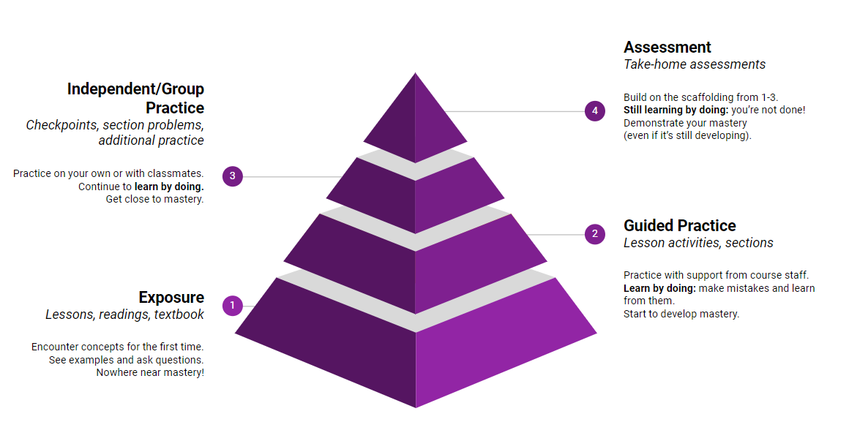
Learning in CSE 143 (or anywhere)

Slide 17
Agenda
About us
About this course
Learning objectives
Other similar courses
Course components
Our learning model
Tools and resources
Course Website
Zoom
Ed
PollEverywhere
Assessment and grading
Collaboration

Slide 18
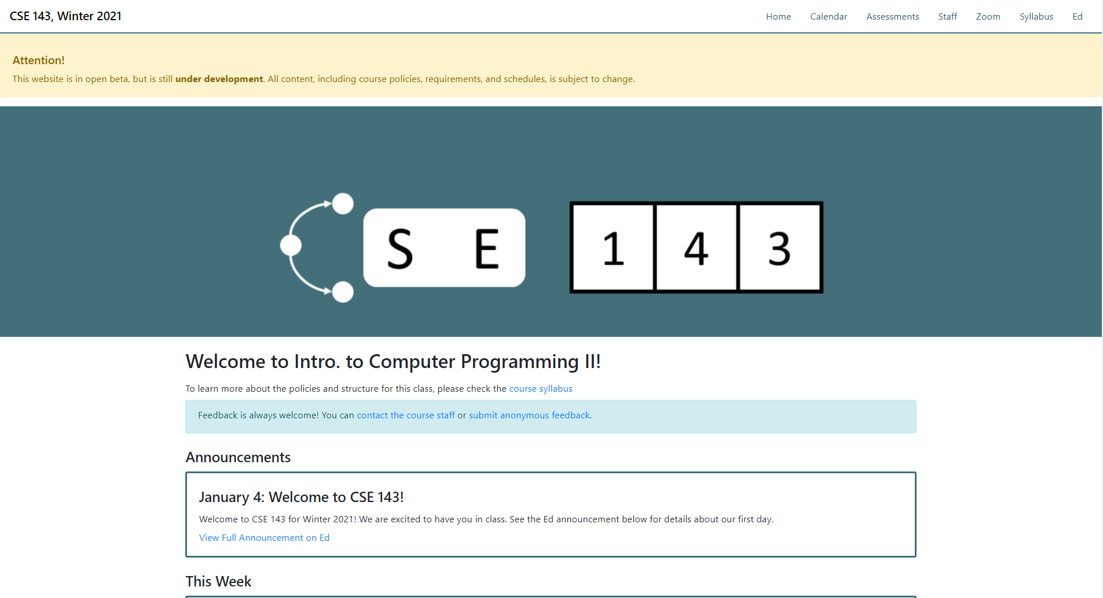
Course Website
cs.uw.edu/143
Primary source of course information (not Canvas)
Calendar will contain links to (almost) all resources

Slide 19
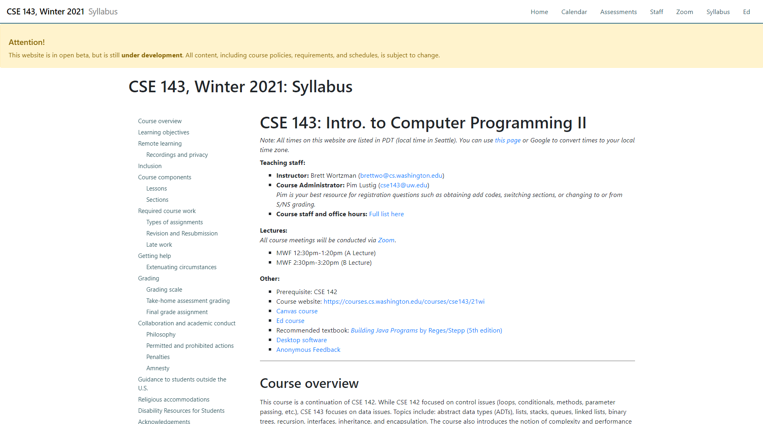
Course Website
Please review the syllabus ASAP.

Slide 20
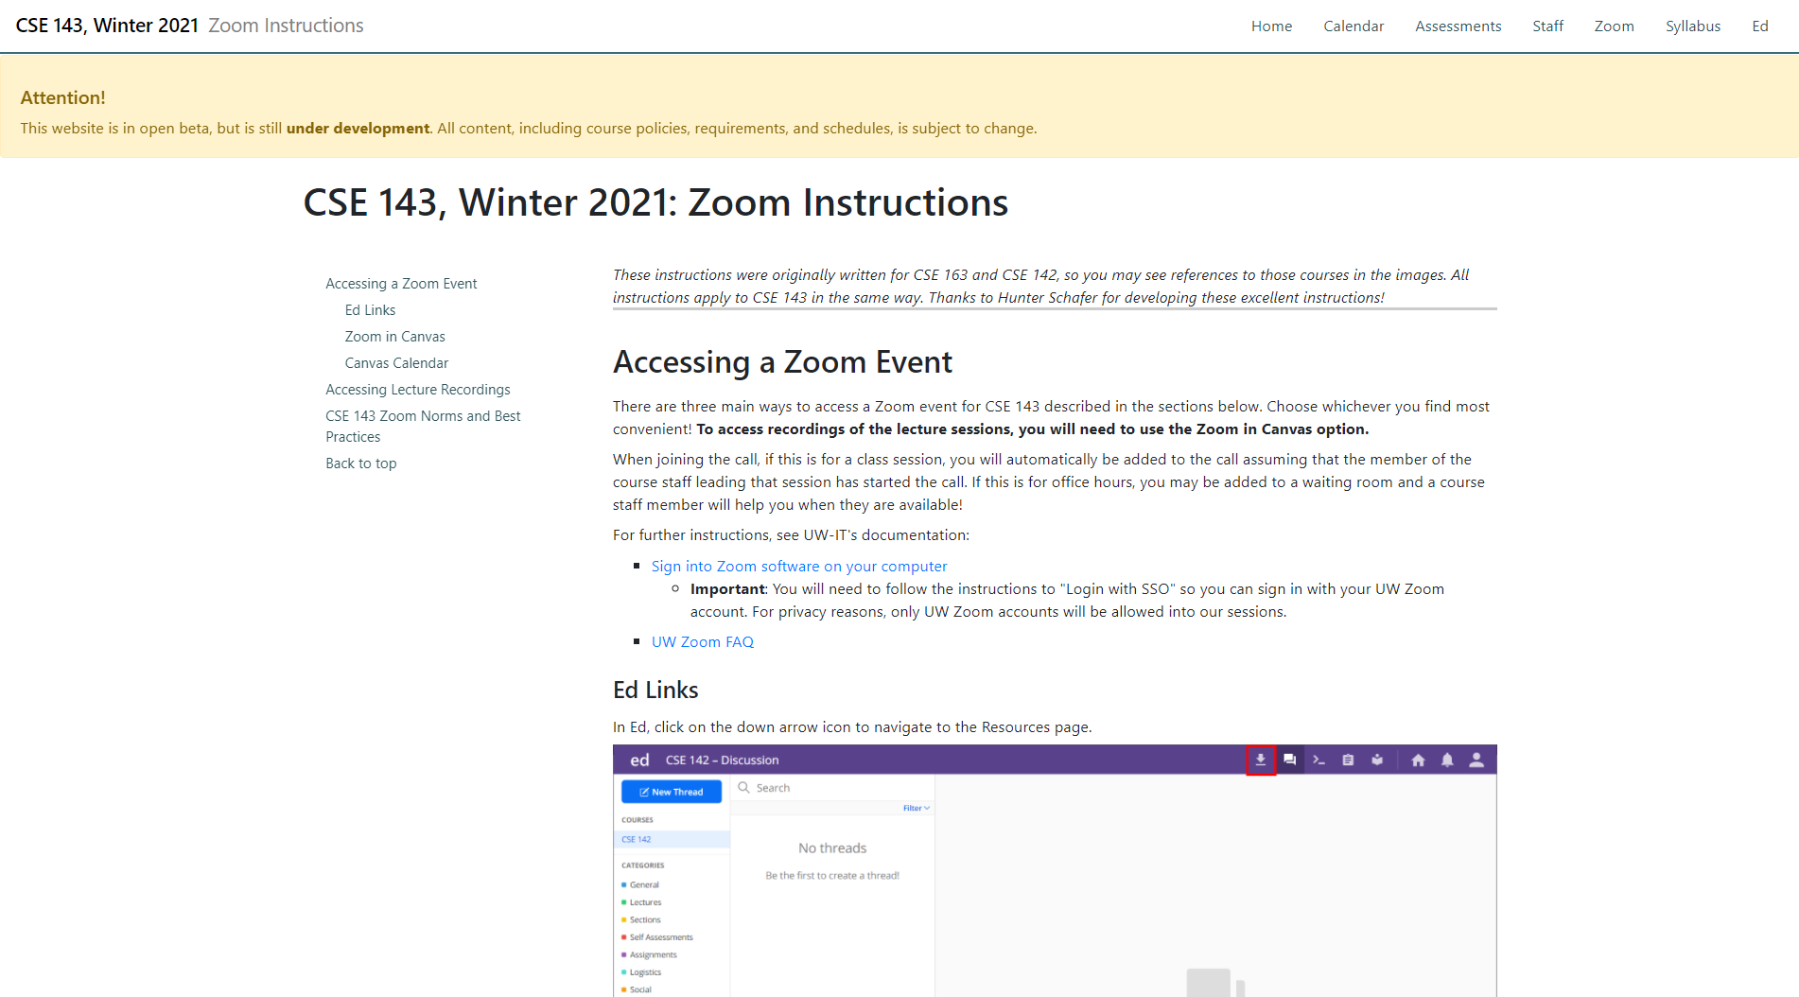
Course Website
Make sure you’re aware of Zoom norms.

Slide 21
Zoom
Keep you microphone muted until called on
Use the “Raise Hand” button to ask to speak
Turn video on if you’re comfortable!
I like seeing your faces. ☺
Chat will usually be disabled in lessons
But we’ll have other options…

Slide 22
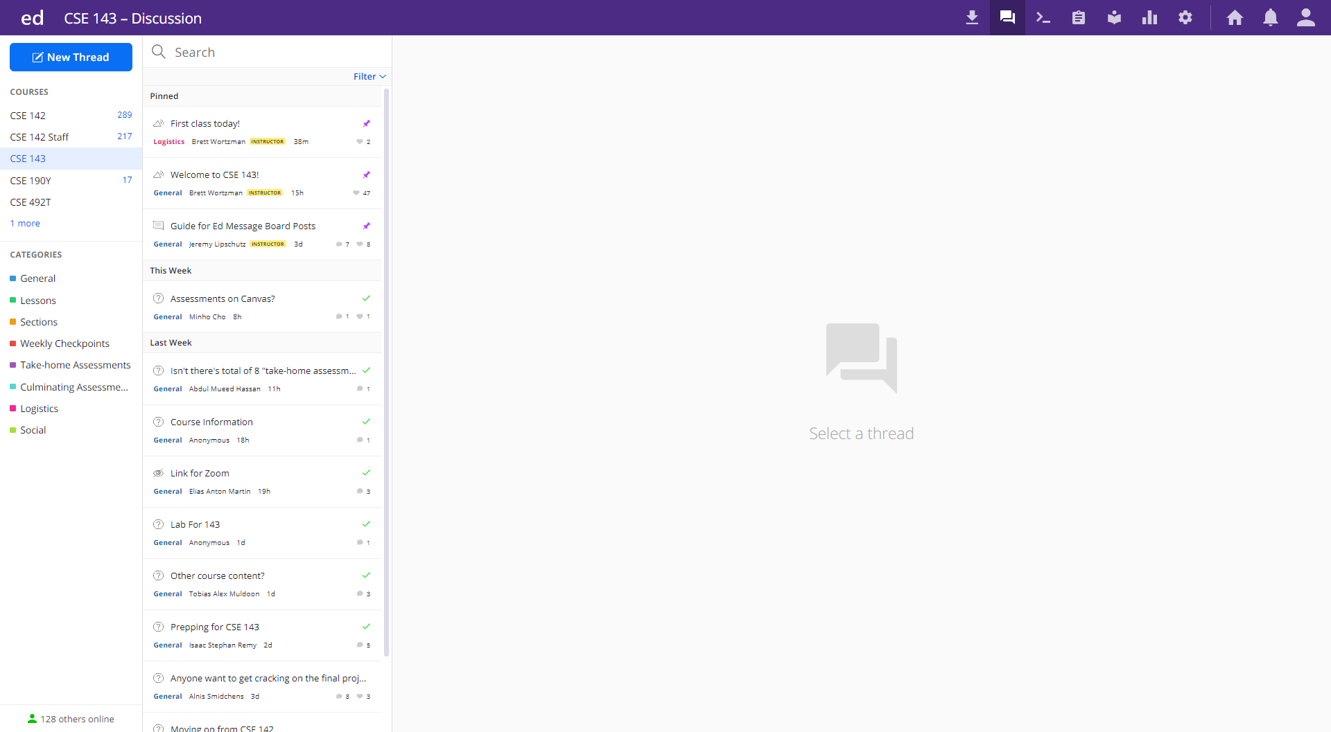
Ed
Our online learning platform
Lessons, sections, labs, assessments all here
Intro and walkthrough video forthcoming

Slide 23
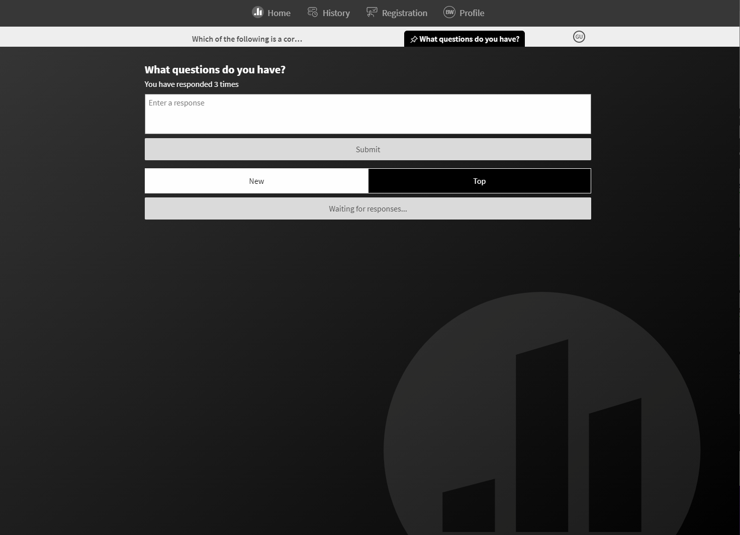
PollEverywhere
pollev.com/brettwo
Two purposes (at least):
Questions backchannel
Ask questions at any time
I’ll check periodically and respond
Some may be deferred
Answers will be posted on Ed after class

Slide 24
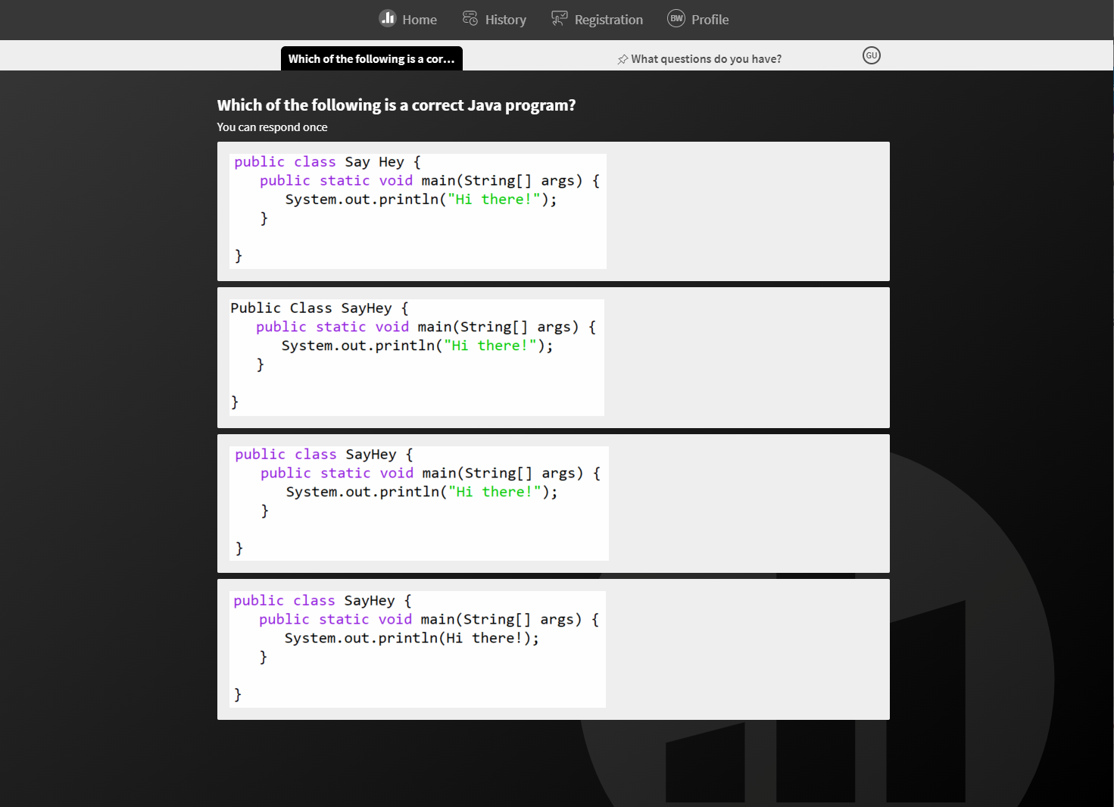
PollEverywhere
pollev.com/brettwo
Two purposes (at least):
In-class activities
Short questions, problems, etc.
Usually multiple choice
Not graded
Not even on participation

Slide 25
Agenda
About us
About this course
Learning objectives
Other similar courses
Course components
Our learning model
Tools and resources
Course Website
Zoom
Ed
PollEverywhere
Assessment and grading
Collaboration

Slide 26
Assessment and Grading
Our goal in the course is for you to master the concepts and skills we teach
We assess your mastery by asking you to apply the concepts and skills on tasks or problems
By necessity, we are assessing your work as a proxy for your mastery
Your final grade should reflect the extent to which you have demonstrated mastery of the course objectives

Slide 27
Assessment
Your learning in this course will be assessed in four ways:
Take-home assessments (~weekly, 8 total)
Large programming assignments to assess your full mastery of that week’s concepts (plus some previous material)
Checkpoints (~weekly, 9-10 total)
Short problems to help you practice and make sure you’ve got the basics for the week
Culminating assessments (2 total)
Series of problems covering all material up to that point
Reflections (w/other assignments, 8-10 total)
Written assignments to help you think critically about your learning and progress

Slide 28
Resubmission
Learning takes time, and doesn’t always happen on the first try
One previous take-home assessment can be resubmitted each week
Initial submission must have been made by original due date and passed verification tests
Must be accompanied by a write-up describing changes
Grade on resubmission will completely replace original grade
See the syllabus for more details

Slide 29
Grading
Grades should reflect your mastery of the course objectives
Checkpoints, culminating assessments, and reflections are graded S (Satisfactory) or N (Not yet)
If you submit on time and meet all requirements, you’ll get an S
Take-home assessments will be grade E (Exemplary), S (Satisfactory), N (Not yet), or U (Unassessable) on four dimensions.
Specifics forthcoming
Final grades will be assigned based on the amount of work at each level
See the syllabus for more details

Slide 30
Collaboration Policy
Learning is hard, but it’s easier when you learn from each other
You are encouraged to form study groups, work together on practice and review, and discuss your ideas and approaches at a high level
If you discuss your ideas with others, you must cite them
All work you submit for grading must be your own
Any work found to not be your own will receive a grade of U on all dimensions and may not be resubmitted
If it’s not your work, we can’t assess your mastery from it
See the syllabus for more details

Slide 31
Amnesty
Sometimes, we make bad choices that we regret
“If you submit work that is in violation of the academic conduct policy, you bring the action to Brett's attention within 72 hours of submission and request amnesty. If you do so, you will receive a grade of U for the initial submission, but you will be allowed to resubmit your work under the normal resubmission process.”
See the syllabus for more details

